Slide 1
Prof. Subodh Wagle, IIT Bombay
TD 638: Development Perspectives
Mainstream Development:
Critiques and Alternatives

Slide 2
Development: Post-Colonial Understanding: Mainstream Model
Success of Keynesian Theory in European Recovery after WW 2 (Marshall Plan)
International Political Agenda of USA to Stop Spread of Communism
National Developmentalism in Developing Countries
Adoption of Growth Theory of Development: Development = Economic Growth (= Increase in GDP) of a Country
Authoritative Intervention = Giving Prescription, Providing Knowledge, Challenging to change beliefs and behavior
Not Colonization but Development of “Underdeveloped Regions”
Transformation (Modernization) of “Traditional societies”, into modern, westernised nations by helping them in their pursuit and attainment of technology, values, and (political) sys­tems of the ‘modern’ western countries.
Mainstream Development Paradigm/ Model = Economic (GDP) Growth + Industrialization + Modernization

Slide 3
Mainstream Development Paradigm: Recap . . . 1
Mainstream Development Paradigm/ Model = Economic (GDP) Growth + Industrialization + Modernization
Economic Growth = Growth of the economy (of a country) over a prolonged period of time.
= Growth in the value of production of goods and services produced in a national economy.
Measured as Increase in Gross Domestic Product [Total value of goods and services produced in a country].
GDP per Capita = Indicator (or Comparator) of development (= production capacity) in a country
Growth in GDP = Increases in production in agriculture, industries, resource extraction, and other sectors.

Slide 4
Mainstream Development Paradigm: Recap . . . 2
Modernization = Transformations:
Technology: Hand-Tool Based and Using Conventional Fuel to Large-Size, Sophisticated, and Using Fossil Fuels,
Economies: Pre-Industrial (Subsistence Agriculture + Artisanal Production) to Industrial Capitalism
Belief Systems, Education: Spiritual/ Religious/ Metaphysical/ Mystic to Rational, Secular
Cultural Norms: Collectivist Values Giving Primacy to Community over Individuals to Primacy to Individual Liberty
Social Systems: Joint Family, Kinship, Caste-based, Communitarian, Mostly Urban
to Nuclear Family, Individualist, Cosmopolitan, Mostly Urban
Political System: Monarchy, Fiefdoms to Liberal Democracy with Universal Suffrage

Slide 5
(Mainstream) Development: Other Key Points
Development = Economic Growth: Assumption that with greater wealth come other benefits such as improved health, education, and quality of life.
Convergence Theory = The claim that
With economic growth
And acceptance of industrial technology, capitalism, modernization and liberal democracy,
income levels among different countries and within all countries will converge soon.
Trickle Down Theory = The argument that once economic growth is achieved in a country,
the benefits of this growth will automatically trickle down to nooks and corners of society
(= automatic increase in income of all of its citizens).
Growth Focus = “our subject matter is growth, and not distribution” Arthur Lewis (Development Economist)

Slide 6
Critique of Mainstream Development . . . 1
By mid-1960s, it was clear that
Economic Growth, Convergence Theory, Trickle Down Theory, and Modernization are not working
Evidence emerged that income inequality between and within countries had increased substantially.
Instead of Convergence, different countries experienced different (positive or negative) effects of development efforts focused on economic growth.
Despite aid programs and development efforts, more wealth continued to flow from the developing countries to developed countries
(for example, as debt repayments, payments for technologies, repatriation of profits of transnational corporations, and consultancy fees).
Wealth disparity between developing and developed countries continued to grow between 1990s and 2015.

Slide 7
Critique of Mainstream Development . . . 2
Mainstream economists dominated development thinking and practice,
whereas development is not about economics alone
Only specific exceptional countries who managed to maintain high rates of economic growth
In 1970s East Asian Giants: Japan, Taiwan, South Korea (1st Generation),
In 1980s Malaysia, Thailand, Indonesia (2nd Generation)
In 1990s China and After 2000s India.

Slide 8
Critique of Mainstream Development . . . 3
Eurocentricity = European orientation/ European path of development as a standard to follow by other countries.
Cultural Arrogance inbuilt in Eurocentricity said to have led to
denigration (= belittling or defamation) of other societies/ cultures/races,
insensitivity to cultural variations,
stereotyping of other societies, cultures, and places as underdeveloped/ barbaric/ uncultured).
Arrogance of universal applicability/ relevance of Grand Theories (Trickle-Down, Modernization)

Slide 9
Critique of Mainstream Development . . . 4
Uni-linearity of development idea:
that all countries and societies will and should follow the same path in the same order
in order achieve economic and societal development as the Western Europe and USA.
Continued dominance of industrialized/ developed/ rich countries,
especially of USA in economic affairs and international politics:
Led to accusation of neo-colonialism (= political control + economic exploitation)

Slide 10
Critique of Mainstream Development. . . 5
“Reductionism”: Collapsing the broad and multidimensional process of development
into a narrow quantified parameter of GDP,
which essentially was a parameter of macro-economic wealth generation,
This led to distortion of development thinking and practice
Over-emphasis on economic growth and on GDP led to neglect of distribution aspect,
leading to increase in not just income disparity but multi-dimensional deprivation
Diverse criticisms of concept, theories, as well as practice of Development
Increasing calls for rethinking development theory and strategies
and for diversified and broader interpretation of development

Slide 11
Development: Beyond Economic Growth . . . 1
Main Assertion: Development is not equal to economic growth or to reducing income poverty.
Denis Goulet: Development should promote
life-sustenance (the basic requirements for survival—food, clothing, health, and shelter),
self-esteem (or dignity and respect to identity of the individual), and
freedom (an expanded range of choices and freedom from “servitudes [= domination]”)

Slide 12
Development: Beyond Economic Growth . . . 2
Dudley Seer: Six conditions necessary for dealing with multi-dimensional poverty & achieving development:
adequate income to cover the needs of basic survival;
employment (including any non-paid social role contributing to self-respect and personality development;
improvement in the distribution of income;
an education, particularly literacy;
political participation; and
national autonomy (belonging to a politically and economically independent nation).

Slide 13
Human Development Index [HDI] . . . 1
Accepting that Development is beyond economic growth makes achieving GDP and GDP/ Capita inadequate
Efforts to bring in other socially-relevant criteria in measurement of Development.
Many new social, economic, and other indicators were suggested,
But, most widely used is Human Development Index [HDI] (proposed and used by UN Agencies)
HDI measures the overall achievements in a country
in terms of three basic dimen­sions of human development –
longevity, knowledge, and a decent standard of living.

Slide 14
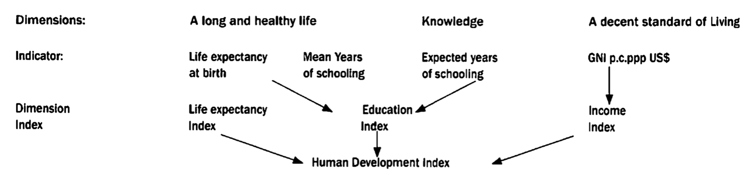
Human Development Index [HDI] . . . 2
HDI is measured by life expectancy,
educational attainment (adult literacy and combined primary, secondary and tertiary enrolment),
plus adjusted income per capita in purchasing power parity (PPP) US dollars.

Slide 15
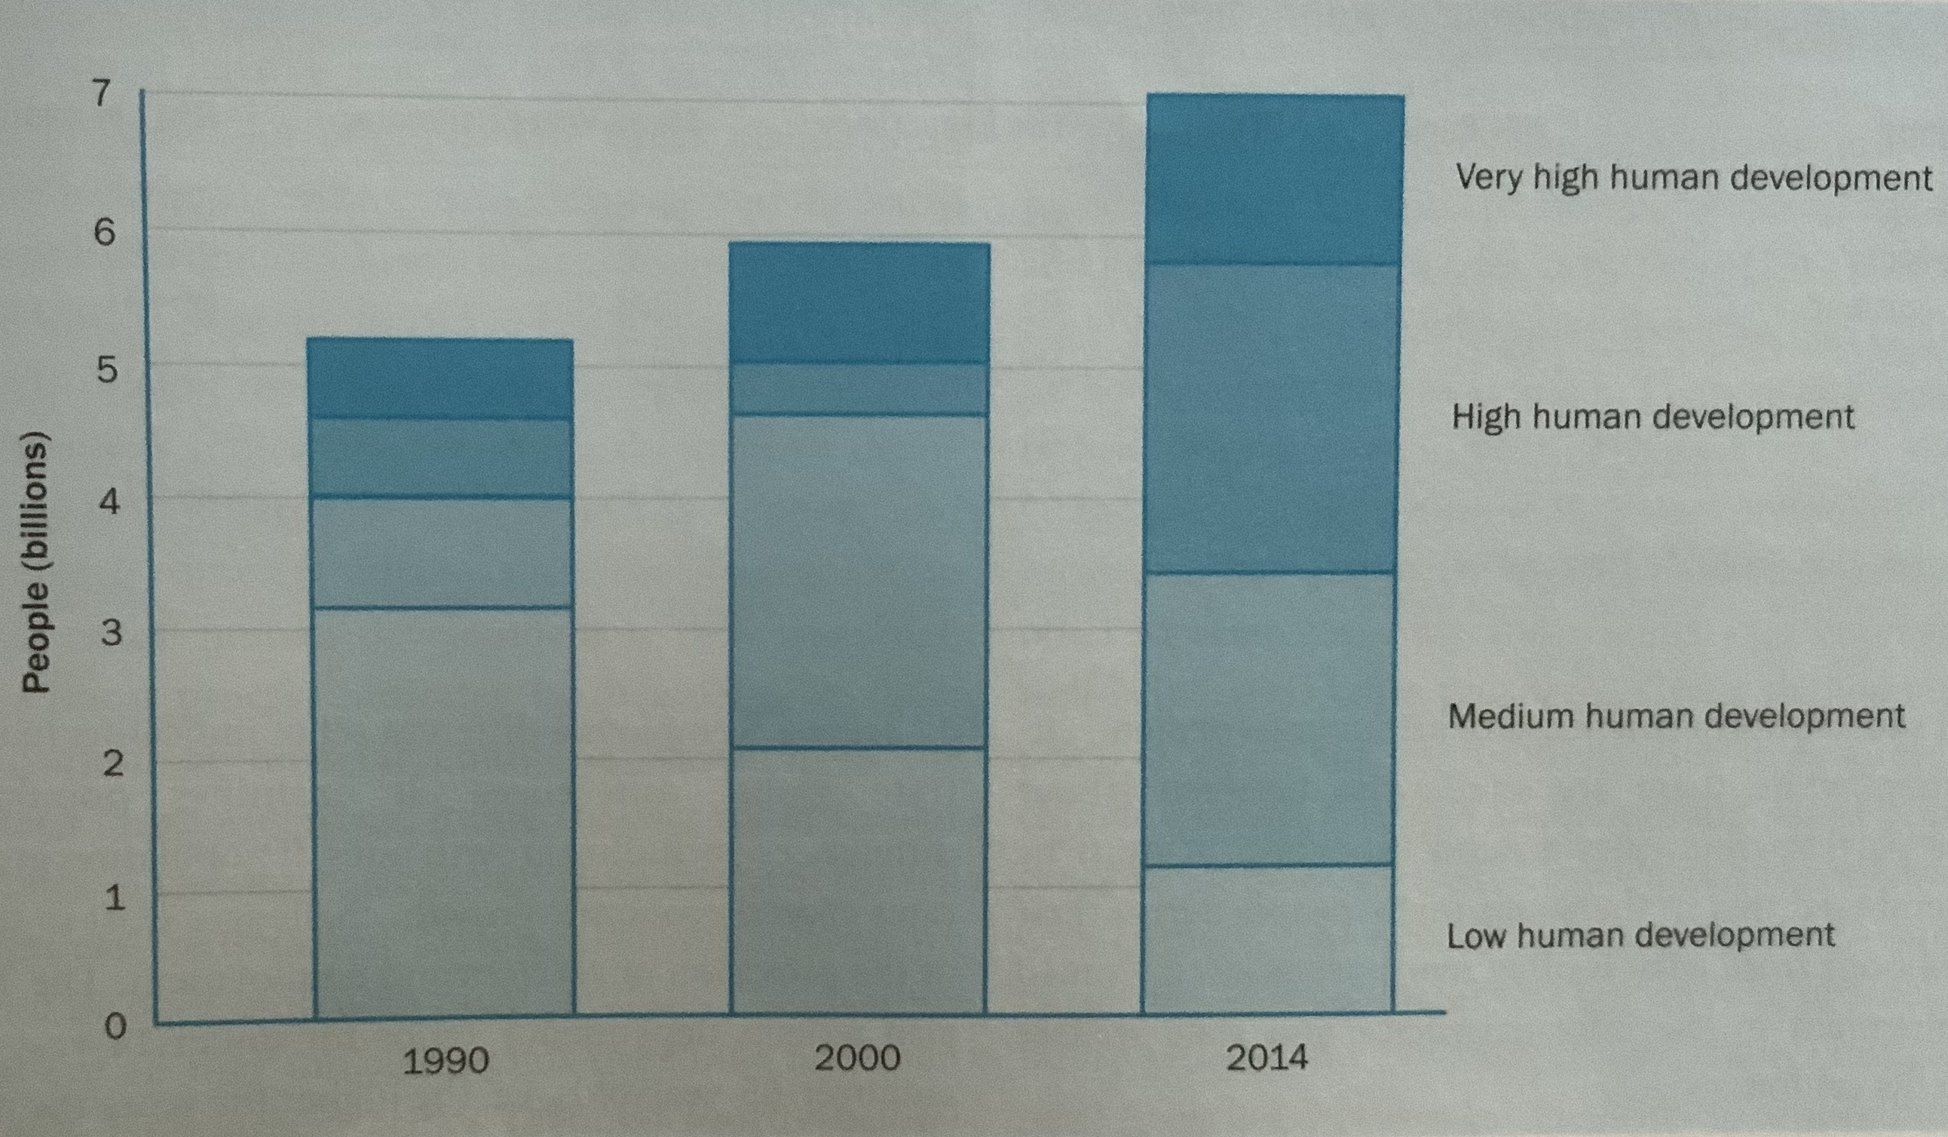
Development: Through HDI Lens

Slide 16
Alternative Development . . . 1
Alternative Development Models/ Paradigms = Other than/ Different from Mainstream Development Model
Core ideas existed before, but received boost after the failure of the Mainstream Development Model
Initial Key Ideas: Gandhian Ideas from Hind-Swaraj: Local Self-Sufficiency in Economic Sphere, Local Self-Governance, Centrality to Moral Values, Dignity of Manual Labour, Primacy to Artisanal Production and Village Industries
Other Key Models of Alternative Development (Developed as Response to failure of the Mainstream Development Model):
Human-Focused Development; Development from Below, Bottom-up Development, Participatory Development, Community-Based Development

Slide 17
Alternative Development . . . 2
Key Strategic Elements in Alternative Development Models:
Micro-level Interventions;
Primacy to Satisfaction of Basic Human Needs;
Focus on Access to Health, Education, and Water Services;
Participation of People in Development Decisions,
Empowerment of Women and Other Socially and Culturally Disadvantaged Groups;
Less Reliance on State and Private agencies
Key Role for Community-based, Self-Service, or Non-Governmental Organizations

Slide 18
Alternative Development . . . 3
Critiques of Ideas and Strategies of Alternative Development Models :
Romantic, Impractical ideas;
NGOs/ CBOs proved ineffective and unaccountable;
Communities are not homogenous or united but are divided and fractious;
Tyranny of Participation = Cost of Participation Unaffordable to Poor
Fallacy of Empowerment = Delegation of Authority and Powers from State Agencies
to Empowered Local Elites and NGOs
and not to Women, Poor, and Disadvantaged sections)

Slide 19
Sustainable Development . . . 1
Diagnoses: Concerns over Climate Change Effects are Serious, Immediate, and Could be Addressed
Environmental destruction, economic growth, and continued deprivation in the South are inter-linked
Definition of Sustainable Development:
Sustainable development is development that meets the needs of the present
without compromising the ability of future generation to meet their own needs
Requirements of Sustainable Development:
Satisfaction of Basic Needs of All (Developing Countries)
Criteria for Economic Growth: ‘Principles of (environmental) Sustainability and Non-Exploitation of Others’ (for Developed Countries).

Slide 20
Sustainable Development . . . 2
Strategic Imperatives: Seven strategic imperatives that nations must take into consideration to make changes in policies and strategies to move toward the goal of sustainable development.
These imperatives include:
Reviving Growth,
Changing the Quality of Growth,
Meeting Essential Human Needs,
Ensuring a Sustainable Level of Population,
Conserving and Enhancing Resources ,
Reorienting Technology and Managing Risk,
Merging Environment and Economics in Decision Making

Slide 21
Critiques of Sustainable Development . . 1
Top-priority ‘strategic imperatives’ is: economic growth (i.e., ‘reviving growth’) with adjunct suggestions to improve it qualitatively by making it less harmful to nature and human beings.
This makes it a reformist-tinkering solution,
i.e., it does not touch the core of the mainstream development perspective—namely, economic growth.
Focus on reforms and superficial managerial modifications in the current economic and technological systems by bringing in environmental considerations.
Inclusion in principles and requirements: local communities, people’s participation, and basic human needs,
but its proposals for actions in its prescription rely on modification of the macro-level institutions and legal structures with naive rhetoric of international cooperation.

Slide 22
Critiques of Sustainable Development . . 2
Strength: Wide acceptance because it is flexible and vague
allowing a wide range of conventional thinkers and planners
to find it comprehensible, acceptable, and ‘practical’.
This flexibility coupled with the conceptual and ideological similarity with the conventional theory and practice,
has made the concept vulnerable to diverse interpretations and subsequent appropriation.
Please refer: Lélé, S. M. (1991). Sustainable development: a critical review. World development, 19(6), 607-621

Slide 23
Sustainable Development Goals (SDGs). . . 1 [2015]
End poverty in all its forms everywhere.
End hunger, achieve food security ... and promote sustainable agriculture.
Ensure healthy lives and promote well-being for all at all ages.
Ensure inclusive and equitable quality education ... for all.
Achieve gender equality and empower all women and girls.
Ensure availability and sustainable management of water and sanitation for all.
Ensure access to affordable, reliable, sustainable and modern energy for all.
Promote sustained, inclusive and sustainable economic growth, full and productive employment and decent work for all.
Build resilient infrastructure, promote inclusive and sustainable industrialization

Slide 24
Sustainable Development Goals (SDGs). . . 2 [2015]
Reduce inequality within and among countries.
Make cities and human settlements inclusive, safe, resilient and sustainable.
Ensure sustainable consumption and production patterns.
Take urgent action to combat climate change and its impacts.
Conserve and sustainably use the oceans, seas, and maritime resources ...
Protect, restore and promote sustainable use of terrestrial ecosystems ...
Promote peaceful and inclusive societies ... access to justice ... accountable and inclusive institutions.
Strengthen the means of implementation and revitalize the global partnership for sustainable development.

Slide 25
Sustainable Livelihoods Approach . . . 1
Sustainable Livelihoods Approach is a way of thinking about
the objectives, scope, and priorities for development activities.
It is based on thinking about how the poor and vulnerable live their lives
and the importance of policies and institutions.
It helps formulate development activities that are:.
People-centered
Responsive and participatory
Multilevel
Conducted in partnership with the public and private sectors
Dynamic
Sustainable

Slide 26
Sustainable Livelihoods Approach . . . 2
Livelihood Needs: Whatever is sought or desired or needed in order to
live/ conduct life of members of family as per the standard of living decided or sought.
Livelihood Needs: In tangible form (food for hunger, water for thirst)
or intangible form (entertainment, protection from nature, protection from social actors).
Livelihood Resources: All tangible (firewood for cooking food) or intangible (comforting music) things and items
needed to satisfy the Livelihood Needs(such as food, shelter, education, entertainment, etc.).
Livelihood Resources could be obtained in diverse manners:
directly drawn from surroundings (e.g., firewood from surrounding vegetation)
or could be bought by paying money or through barter exchange
or through gifts or sharing.

Slide 27
Sustainable Livelihoods Approach . . . 3
Livelihood Activities: These are the activities conducted
to obtain and/or process livelihoods resources
in order to satisfy livelihood needs.
Livelihood Activities include activities needed for
Social and biological reproduction: These are the activities needed to perpetuate the family and society.
Biological reproduction activities would include: pregnancy, care of baby and mother, care of elderly.
Social reproduction activities would include: education and in-tangible aspects of social grooming.
Livelihoods Stocks: These are storages of livelihoods resources (largely in the same form)
which can be directly utilized to satisfy livelihood needs.
Generally, these Livelihoods Stocks are available for at will to the person
to use as Livelihood Resources for satisfying Livelihood Needs

Slide 28
Sustainable Livelihoods Approach . . . 4
Livelihood Assets: These are things that can be converted into or used for
obtaining livelihoods resources in the case of need.
Livelihood Assets are not in the form of livelihoods resources and
cannot be directly utilized for satisfaction of livelihood needs.
Livelihood Assets could be obtained or developed in diverse manners:
converted from livelihood resources through some processes
bought using money or bartered against livelihood resources or
gifted or shared (not in exchange of anything) by other community members.
Livelihood Assets can be converted into livelihoods resources in the same mechanisms in the reverse directions.
Some Livelihood Assets may provide a stream of livelihoods resources (including money) with or without attrition. (e.g., Bank FD’s provide constant stream of income but reduces its value over a period).

Slide 29
Sustainable Livelihoods Approach . . . 5
Human assets/ capital, e.g., health, nutrition, education, knowledge and skills, capacity to work, capacity to adapt
Social assets/ capital, e.g., networks and connections (patronage, neighbourhoods, kinship), relations of trust and mutual understanding and support, formal and informal groups, shared values and behaviors, common rules and sanctions, collective representation, mechanisms for participation in decision-making, leadership
Natural assets/ capital, e.g., land and produce, water and aquatic resources, trees and forest products, wildlife, wild foods and fibres, biodiversity, environmental services
Physical assets/ capital, e.g., infrastructure (transport, roads, vehicles, secure shelter and buildings, water supply and sanitation, energy, communications), tools and technology (tools and equipment for production, seed, fertilizer, pesticides, traditional technology)
Financial assets/ capital e.g., savings, credit and debt (formal, informal), remittances, pensions, wages
Financial assets/ capital tends to be the least available livelihood asset of the poor. Indeed, it is because the poor lack it that the other types of capital are so important to them

Slide 30
Sustainable Livelihoods Framework
Basic Dynamics
Livelihood
Assets
Can be converted in both ways
Livelihood Resources
Can be converted
in both ways
Can be converted
in both ways
Livelihood Stocks
Are Needed for
Livelihood Needs
Livelihood Activities
Livelihood Outcomes
Satisfied through
Produce

Slide 31
Sustainable Livelihoods Approach . . . 7
Livelihood strategies aim to achieve livelihood outcomes.
Decisions on Livelihood strategies may invoke
natural-resource-based activities, nonnatural resource-based and off-farm activities, migration and remittances, pensions and grants, intensification versus diversification, and trade-off between short-term versus long-term livelihood outcomes,
some of which may compete.
Potential livelihood outcomes can include
more income, increased well-being, reduced vulnerability, improved food security, more sustainable use of the natural resource base, and recovered human dignity, between which there may again also be conflict

Slide 32
Sustainable Livelihoods Approach . . . 6
Vulnerability: Insecurity in well-being of individuals, households, and communities
in the face of changes in their external environment.
Vulnerability has two facets:
an external side of shocks, seasonalities, and critical trends; and
an internal side of defencelessness caused by lack of ability and means to cope with these.
The Vulnerability Contexts includes
shocks, e.g., conflict, illnesses, floods, storms, droughts, pests, diseases
seasonalities, e.g., prices and employment opportunities
critical trends, e.g., demographic, environmental, economic, governance, and
technological trends

Slide 33
Sustainable Livelihoods Approach . . . 8
Livelihood Strategies and Livelihood Outcomes are dependent on
access to capital/ assets or
constrained by the vulnerability context; they
are also transformed by the environment of structures and processes.
Structures
Structures are the public and private sector organizations that
set and implement policy and legislation;
deliver services; and
purchase, trade, and perform all manner of other functions
All these Structures affect Livelihood Strategies and Livelihood Outcomes .

Slide 34
Sustainable Livelihoods Approach . . . 9
Processes
Processes includes laws, regulations, policies, operational arrangements, agreements, societal norms, and practices
that, determine the ways in which structures operate.
Policy-determining structures (public and private sector organizations) cannot be effective
in the absence of
appropriate institutions and processes through which policies can be implemented.
Processes are important to every aspect of livelihoods.
Structures
Livelihoods (Needs. Resources, Sticks, Assets, Strategies, and Outcome)
Policies
Institutions & Processes

Slide 35
Sustainable Livelihoods Approach . . . 10
Processes (= laws, regulations, policies, operational arrangements, agreements, societal norms, and practices)
Processes are important to every aspect of livelihoods.
Processes provide incentives that stimulate people to make better choices.
Processes grant or deny access to assets.
Processes enable people to transform one type of asset into another through markets.
Processes have a strong influence on interpersonal relations.
One of the main problems the poor and vulnerable face is that the Processes
which frame their livelihoods
may systematically restrict them
unless the government adopts
pro-poor policies that, in turn, filter down to legislation and even less formal processes.

Slide 36
Sustainable Livelihoods Framework
Basic Dynamics
Livelihood
Assets
Can be converted in both ways
Livelihood Resources
Can be converted
in both ways
Can be converted
in both ways
Livelihood Stocks
Are Needed for
Livelihood Needs
Livelihood Activities
Livelihood Outcomes
Satisfied through
Produce

Slide 37
Sustainable Livelihoods Framework
Livelihood
Assets
Can be converted in both ways
Livelihood Resources
Can be converted
in both ways
Can be converted
in both ways
Livelihood Stocks
Are Needed for
Livelihood Needs
Livelihood Activities
Livelihood Outcomes
Satisfied through
Produce
Processes
Structures
Vulnerability Contexts

Slide 38
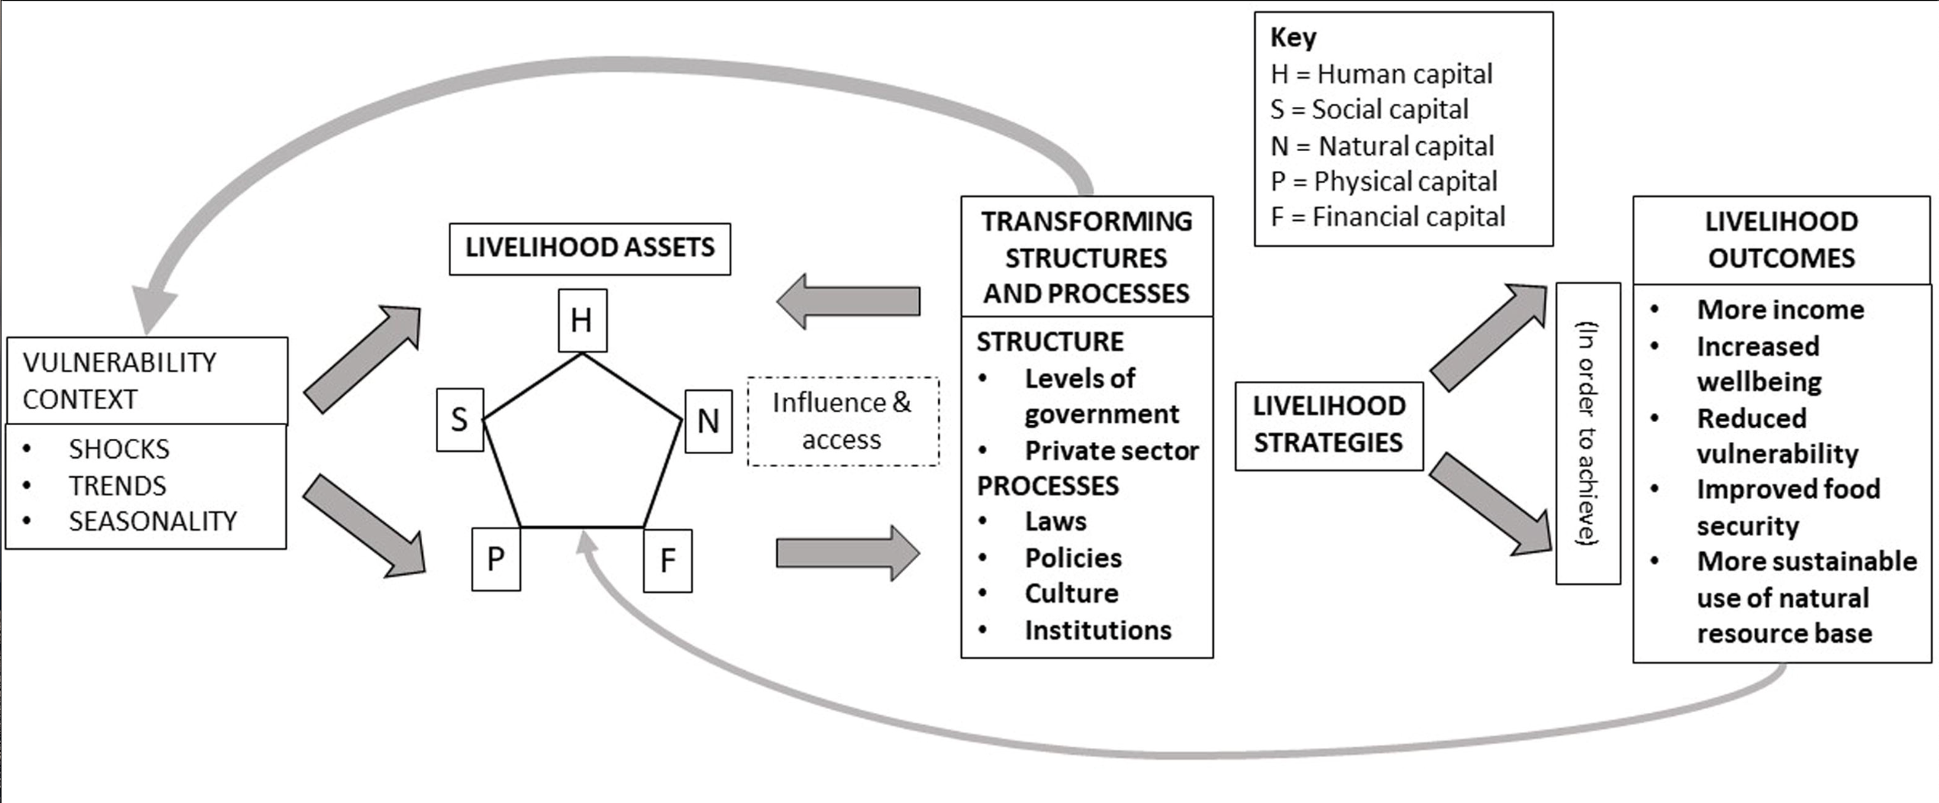
Sustainable Livelihoods Framework

Slide 39
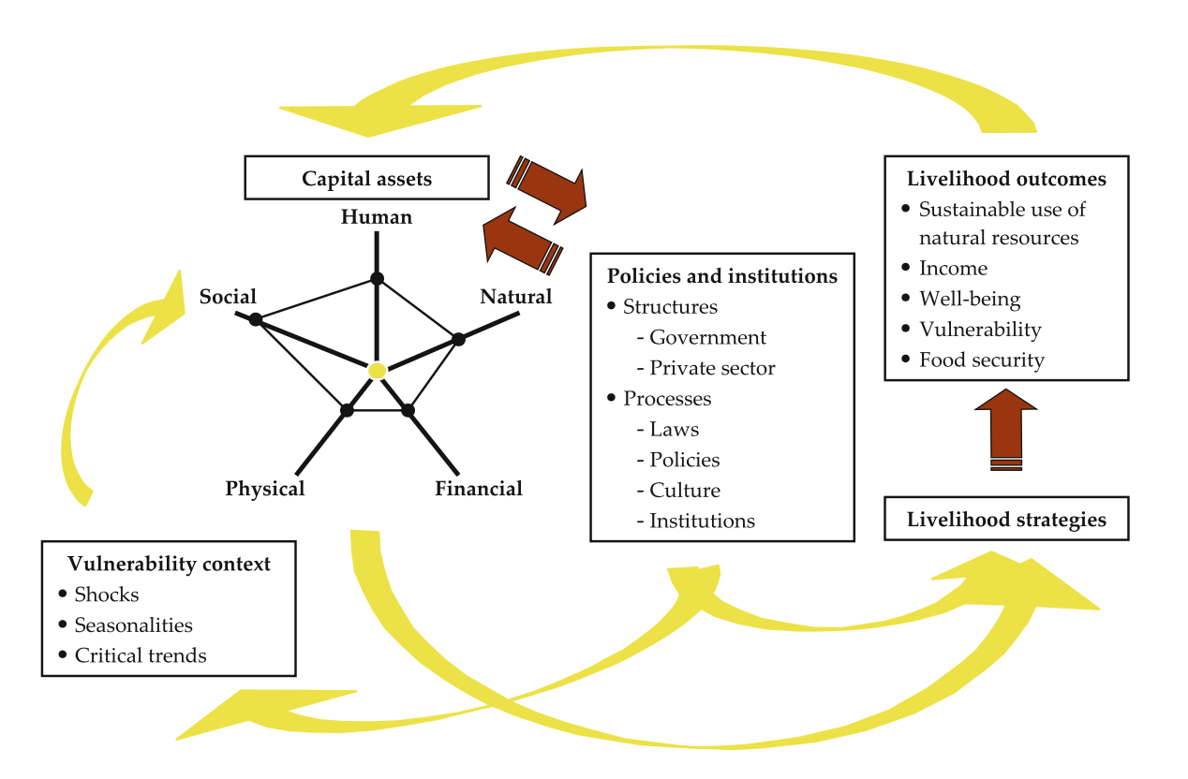
Sustainable Livelihoods Framework

Slide 40
Critiques by Post-/ Anti-/ Beyond Development: . . 1
Genesis of Post-Development : This was a reaction from radicals against utter failure of both:
Mainstream Development Model (economic growth + industrialization + modernization+ liberal democracy + market)
AND Marxist model for progress (economic growth + industrialization + modernization+ Party Dictatorship + Planning)
Main Criticism of the Mainstream Development Model by Post-Development:
Apart from the utter failure on the social and environmental fronts
The idea and discourse on development
is an unfair and heavily manipulated by the West, the International Institutions (UN, World Bank, IFIs), and national governments
which themselves took over the authority to talk about and do development.
In other words, the economic, social, and political parameters of development are set by the West and are imposed on other countries in a neo-colonial mission to develop them in the image of the West.

Slide 41
Critiques by Post-/ Anti-/ Beyond Development . . 2
‘Globalisation Steamroller’ (= ‘universalism’ of contemporary development discourse) is obliterating the local values and potentialities of ‘tradi­tional’ communities
Development created ‘abnormal­ities’ such as poverty, underdevelopment, backwardness, landlessness, and
addressed them through a normalisation programme denying value or initiative to local cultures.
The negative role of the state in the South in facilitating the ‘Westernisation’ of the so-called ‘development mission’.
In the case of the Marxist model for progress (economic growth + industrialization + modernization+ Party Dictatorship + Planning)
The criticism was the same, here one philosophy/ ideology/ political party took over the authority to talk about and do development

Slide 42
Post-Development: Solution . . . 1
The state in the South played a negative role in facilitating the so-called ‘development mission’.
It follows, therefore, that the restructuring of development must come from below and not from the State
Post-development places enormous emphasis not just on grassroots participation,
but more specifically on new social movements as the medium of change,
which can lay a basis for situationally and commu­nity relevant, appropriate “change” (not development).
Not ‘old’, ‘class-based’ ‘social movements’ in the nineteenth century (trade unions, political parties, etc.)
Reason: These allow the pursuit of mainstream development objectives (chiefly, the economic growth).

Slide 43
Post-Development: Solution . . . 2
New Social Movements pursue “anti-development, promoting egalitarian, democratic and participatory politics within which they seek autonomy through the use and pursuit of everyday knowledge”.
Often, ‘transcending any narrow materialist concerns’
It warns against subversion by the developmentalist mission through compromised projects such as ‘women and development’, or ‘grassroots (alternative) development’

Slide 44
Criticisms of Post-Development . . . 1
Reductionism: Post-Developmentists painting a picture in which a monolithic capitalism,
particularly in the guise of the World Bank, monopolizes development within a largely complacent South.
Post-Developmentists are Selective in choosing evidence.
They ignore evidence in Asia-Pacific countries and many positive changes brought about by development (= improved health, education) though they are uneven.

Slide 45
Criticisms of Post-Development . . . 2
Their solutions are not realistic, failed to provide significant and viable alternatives;
new social movements though effective in voicing valid dissatisfaction,
remained at the micro-level, difficult to replicate.
Counter-argument by Post-Developmentists : The national states and Western forces came together to crush new social movements that could not muster
adequate support from the poor, the only natural constituency of new social movements .
who had to fight daily battles for survival.
Despite all these weaknesses, the new social movements were successful in forcing the state and the West to start respecting local people’s views.

Slide 46
Post-Modernism in Development Thinking . . . 1
Two major relevant implications of the broader discourse of postmodernism for development thinking
Postmodernism denies a process of progression to ‘higher’ levels of civilization in human history.
It sees History as a contingent succession of events, so it is difficult to think in terms of goals, including development goals (Parfitt, 2002).
So, development as ‘a process of directed change’ is a myth (=an idea believed by some people but is false).
Postmodernism rejects the interpretation (by the West) of history
as progress or development towards better conditions. (Thus, rejects Promise of Human/ Social Progress)
Similarly, efforts to carve a ‘developmental path’ for the South is also a myth

Slide 47
Post-Modernism in Development Thinking . . . 2
Two major relevant implications of postmodernism for development thinking
Grand Narratives or meta (=super-higher level) theories (e.g., modernization, Trickle - down, Workers’ Revolution)
are also myths,
and Especially their ability to predict the future is a myth.
Hence, Postmodernism recommends Moving to meso- or micro-level conceptualizations (of development/ change),
which focus on specific issues/ dimensions of development
checking their relevance for both the development process as a whole and to local situations.
Postmodernism focuses attention on context and thus avoids meta-narratives independent of context.
Postmodernism privileges the knowledge and experience of those in the local situation to which policy was directed.

